Slide 1


Sentiment Analysis
180030646
180030887
180030956

Slide 2


Slide 3


Slide 4

Problem Statement
To build and identify a suitable ML model for the sentiment analysis of customer reviews using supervised machine learning techniques

Slide 5

Abstract
Sentiment analysis is a way to analyze the subjective information in a text and mine the opinion, hence giving it another name - “Opinion Mining”

Slide 6
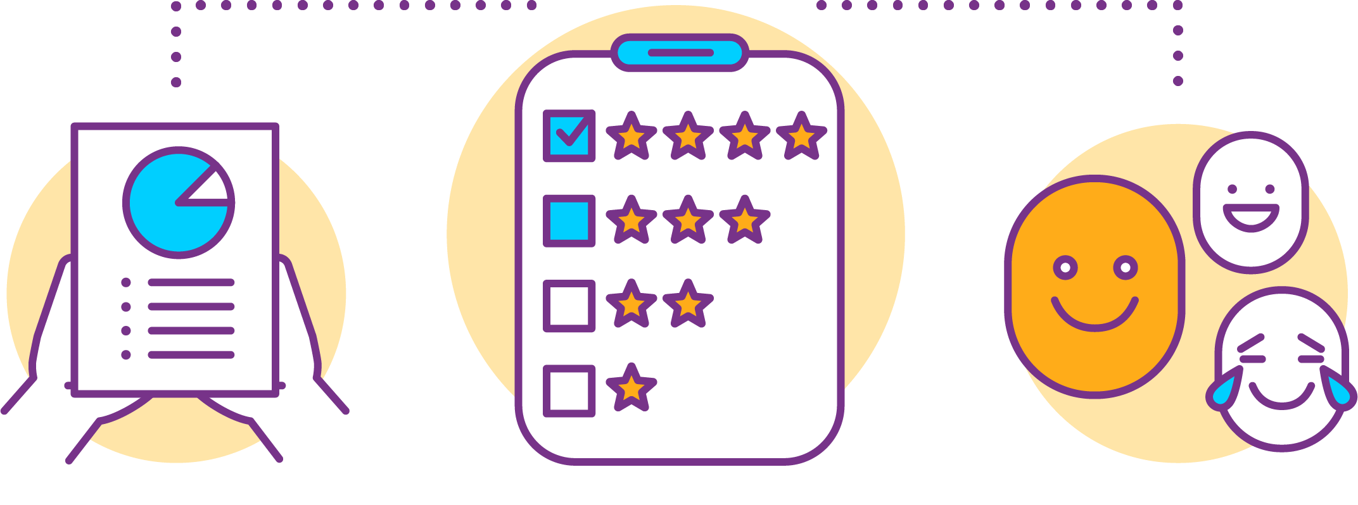
It is a process by which information is extracted from a writing that has different polarities; a type of classification where the data is classified into different classes
Binary
Multi-class
1. Positive
2. Negative
3. Neutral

Slide 7

Project Workflow
Feature Extraction
Data Acquisition
Model selection and Training
4
Data Analysis and Visualization
1
Evaluating the model
5
Pre-processing data
2
6
3

Slide 8
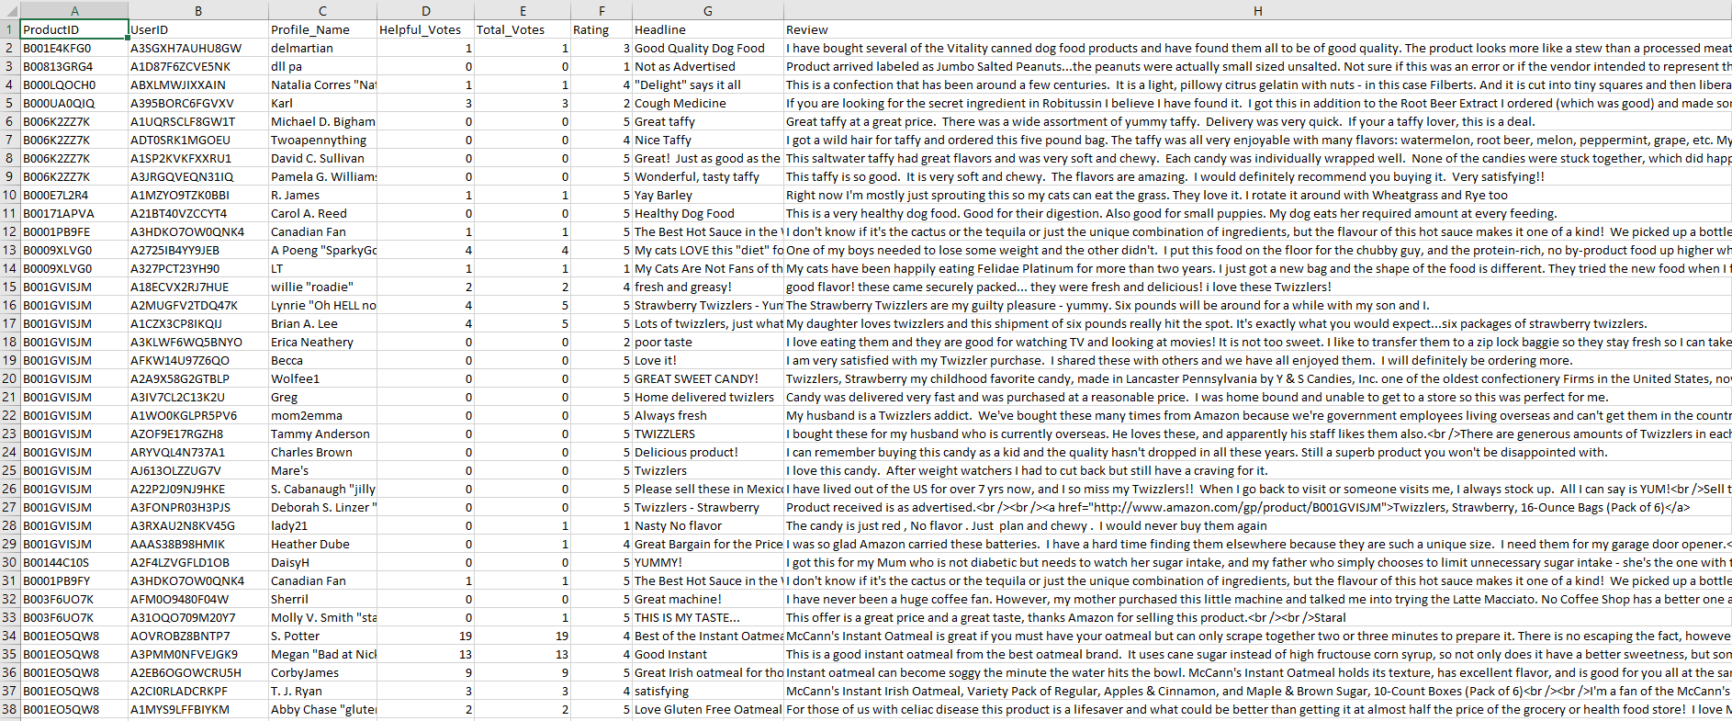
Dataset

Slide 9

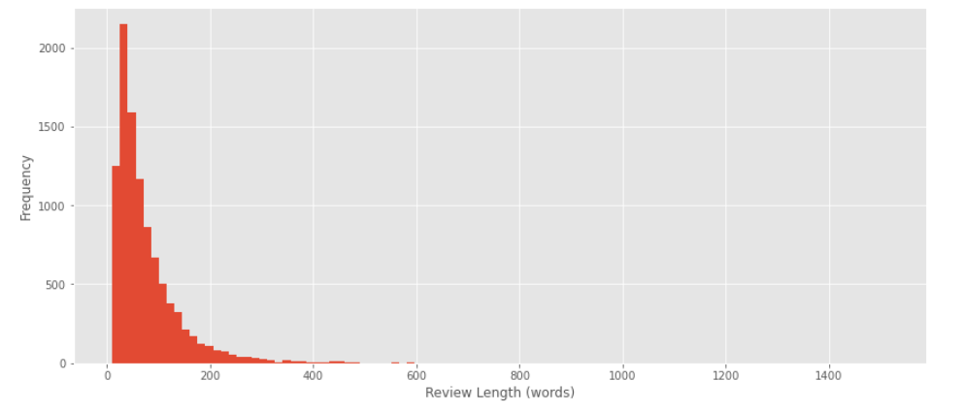
Data Visualization

Slide 10
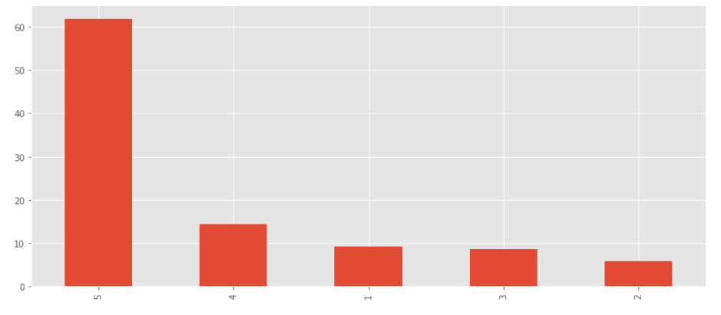

Slide 11
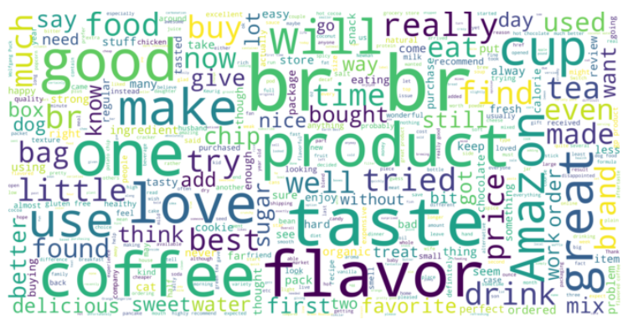

Slide 12
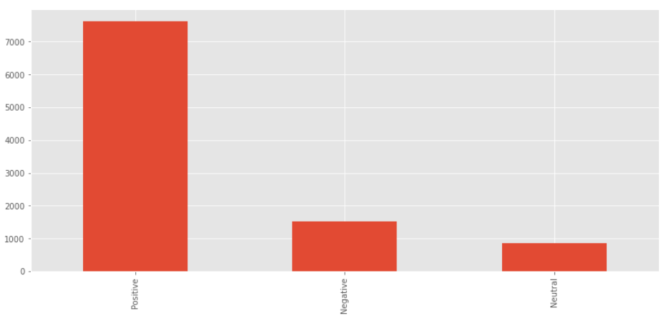
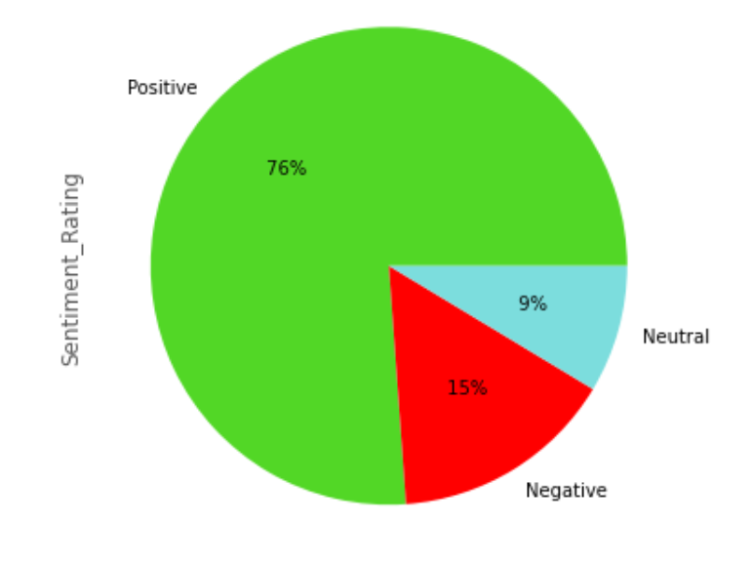

Slide 13

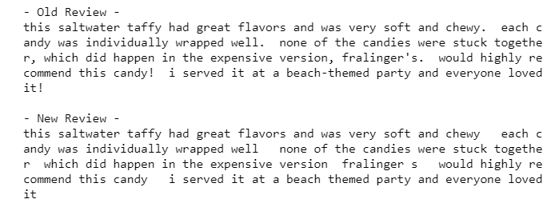
Pre-processing data
Converting words into upper/lower case
Removing special characters

Slide 14
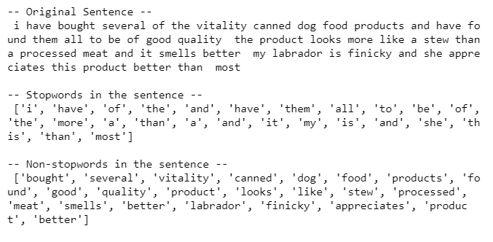
Stopwords
Stemming and Lemmatization

Slide 15
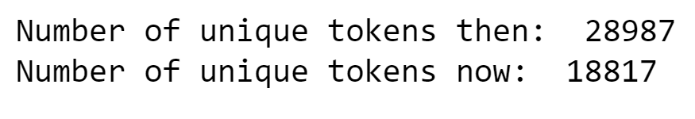


Slide 16

Feature extraction
Review text is converted into a numerical representation of vector form and this is referred to as featurization.
Various featurization techniques available are:
1. Bag – of – words
2. TFIDF Vectorizer
3. Word2vec

Slide 17

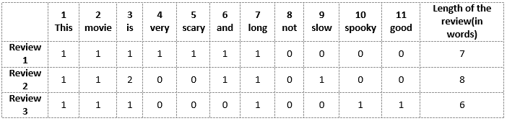
Bag-of-words
Each word is used as a feature for training the classifier
Text vectorization - create a matrix of the features by assigning a separate column for each word while each row corresponds to a review

Slide 18
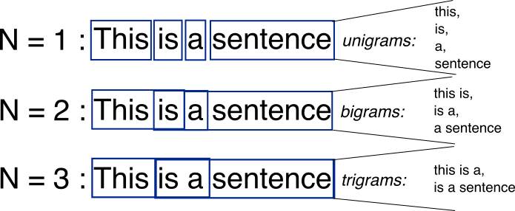

Drawbacks:
Order of occurrence of words is lost as we create a vector of tokens in the randomized order
Does not take the low frequency n grams into account as the higher average count values on words overshadow the shorter ones in many cases

Slide 19


TFIDF Vectorizer
It highlights a specific issue that might not be too frequent but is of great importance
Term frequency (TF): specifies how frequently a term appears in the review w.r.t the total number of words in the review
Inverse document frequency (IDF): measure of whether a term is rare or frequent across the reviews

Slide 20
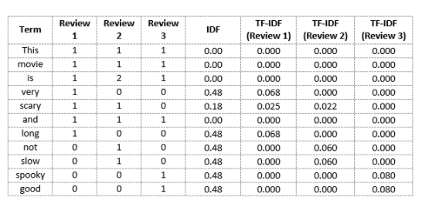

Slide 21
Model Selection and Training
1.
Logistic Regression
KNN Classifier
2.
Support Vector Classifier
3.

Slide 22

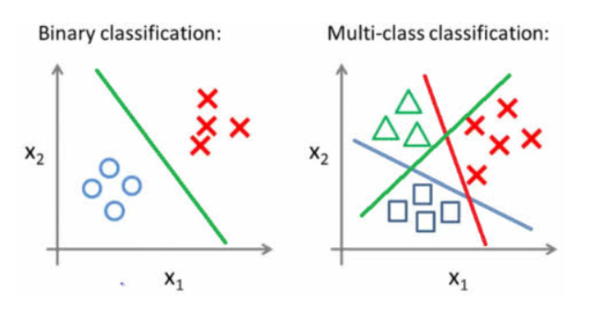
Logistic Regression
Binary classification: two instances are present in the dataset
Multi – class classification: multiple class labels are present

Slide 23
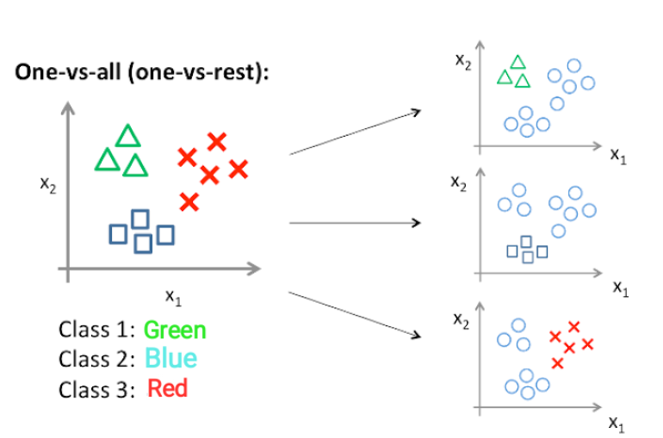
Used when the dependent variable is categorical
Follows the one vs all method

Slide 24
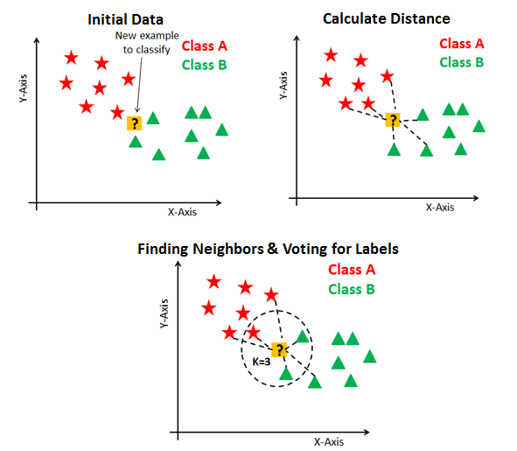

KNN Classifier
Assumes that things exist in close proximity
Output is calculated as the class with the highest frequency form k – most similar instances
Each instance votes for their class and the class with the most votes is taken as the prediction

Slide 25

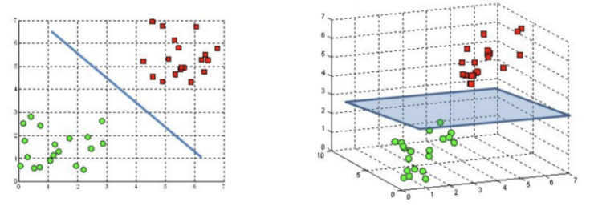
Support Vector Classifier
To find a hyperplane in an N-dimensional space that distinctly classifies the data points and has the maximum margin
The dimension of the hyperplane depends on the number of features

Slide 26
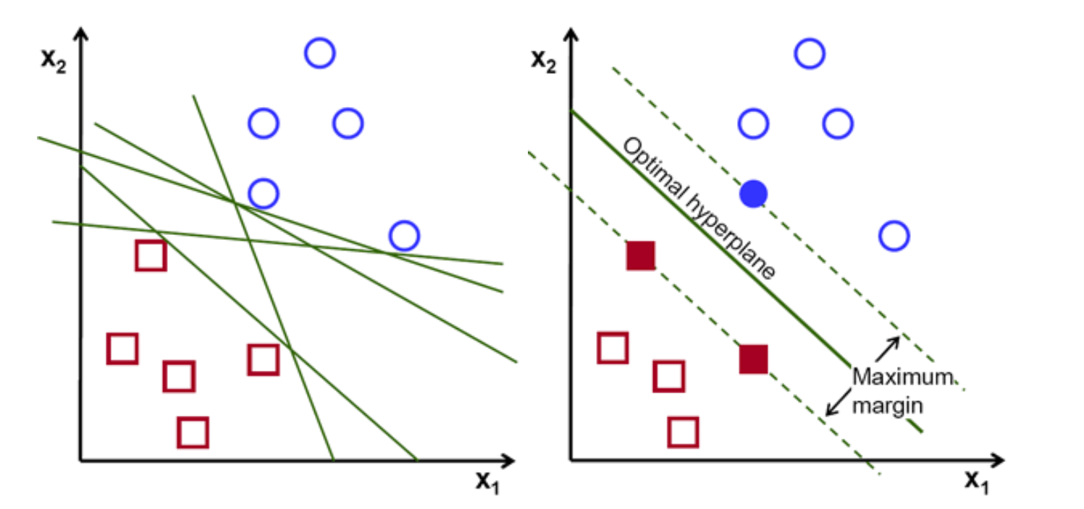
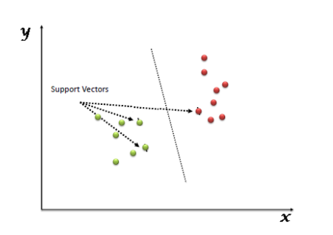
Support vectors are data points that help us build our SVM
They are closer to the hyperplane and influence the position and orientation of the hyperplane

Slide 27
Accuracy
Model | Accuracy (Bag-of-words) | Accuracy (TFIDF Vectorizer)
Logistic Regression | 0.836 | 0.831
KNN | 0.764 | 0.824
SVC | 0.793 | 0.775

Slide 28
Thanks!

